Slide 1
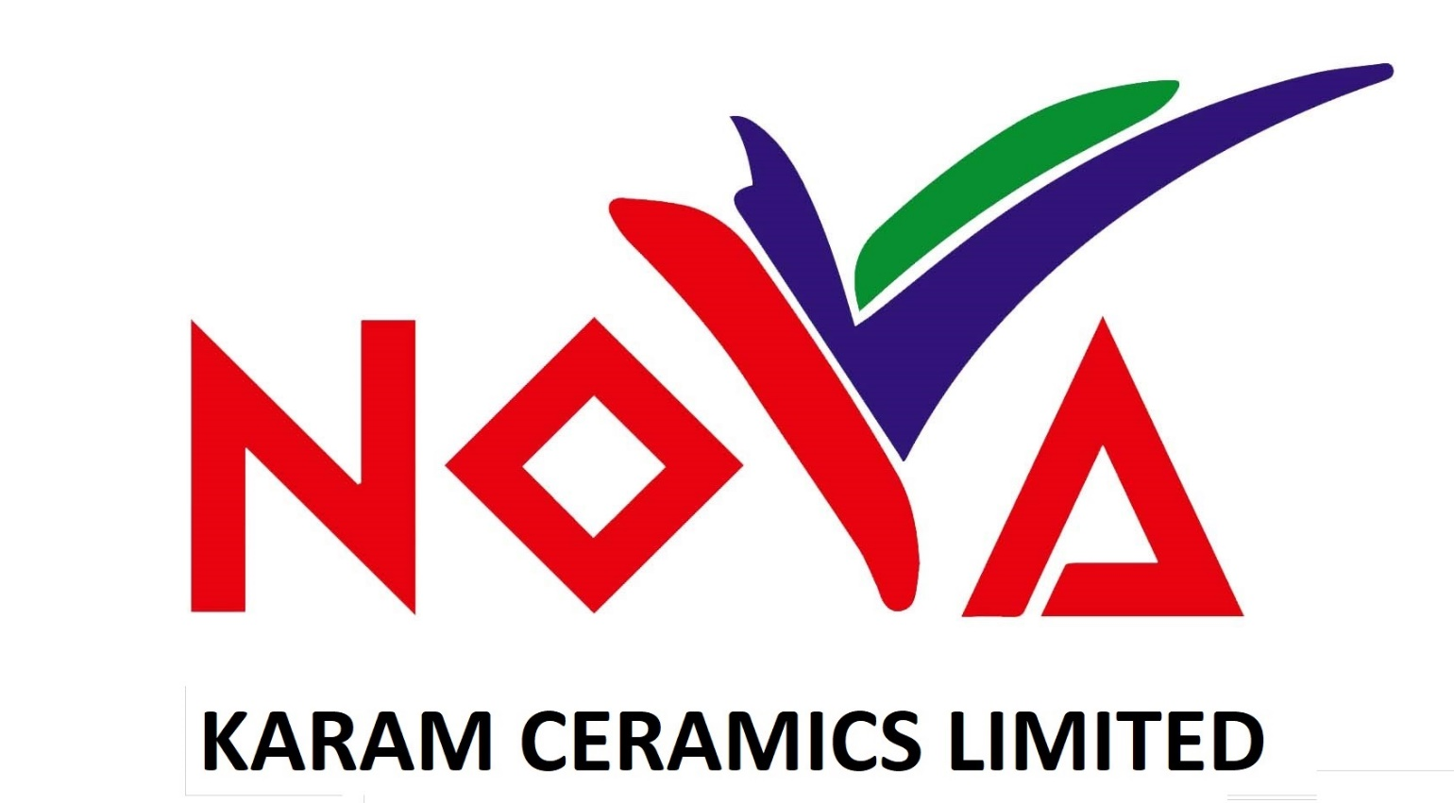
Scheduled on:09/01/2023 At 11:00 A.M.
CORPORATE BRIEFING SESSION
FOR THE YEAR ENDED JUNE 30, 2022

Slide 2
Agenda of the Session:
About Karam Ceramics Limited
Products Portfolio
Financial Highlights of 2021-22
Financial Highlights of Three Months ended September 31, 2022.
Key Challenges
Q & A Session

Slide 3
About Karam
Karam Ceramics Limited (the Company) was incorporated n Pakistan on April 8, 1979 as a public limited company under the repealed Companies Act, 1913 ( now Companies Act,2017) The shares of the Company are quoted on Pakistan Stock Exchange. The registered office of the Company is situated at present address “A-31, Sindhi Muslim Cooperative Housing Society, Karachi previous address. BC-6, Block 5, Kehkashan , Clifton Karachi, Pakistan and manufacturing facilities of the Company are located at 295/311, Deh halkani, Hub Dam Road ,Manghopir , Karachi. The principal activity of the Company is manufacturing and sale of tiles.
On November 12, 2021 intention for the acquisition of 95.6% shares of the company was made by Swat Ceramics (Private) Limited (SCPL) in accordance with Securities Act2015 and the Listed Companies (Substantial Acquisition of Voting Shares and Takeovers) Regulations,2017 However, the proposed acquisition was changed where by the proposed acquisition was offered by sponsors of SCPL Company rater then the SCPL it self.
On March 04, 2022 the proposed acquirer entered in to an share purchase agreement with the sponsors of the Company for the purchase of 10,613,259 shares which represents 72.95% of the total capital of the Company at a price of Rs 20per ordinary share. Further, a public announcement was made on May 13, 2022 for the purchase of additional 1,967,700 ordinary share which represents 13.52% of the total capital of the Company at a price of 62.77 per ordinary share, out of which 536,813 shares were obtained from minority share holders.
The new management has taken over on July 26,2022
New Management has selected bard name ‘’NOVA”

Slide 4
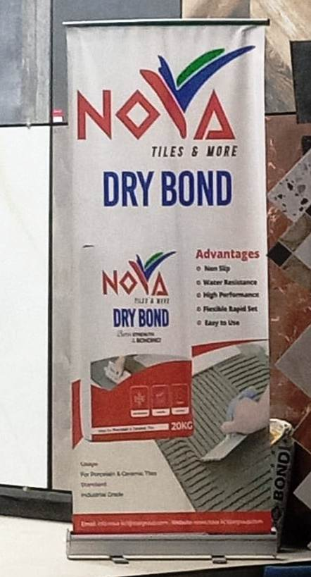
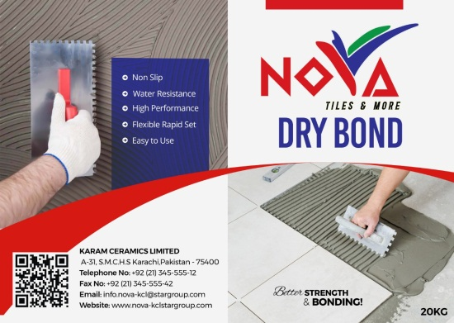
Why Karam Ceramics Ltd?
We are committed to provide the Best Quality products to our customers.
Company introduced NOVA DRY BOND a thin set of motor for the industrial of Tiles.
Research & development is the backbone of NOVA.
NOVA understands today's fast moving, high-tech world and are dedicated to provide consistent high quality standards to customers. Our employees stay committed to produce and maintain our best quality tiles right from the design conception stage to the production stage.
We are a Public Limited Company listed on Pakistan Stock Exchange.
Karam Ceramics Limited with brand name NOVA is equipped with the latest state of art technology and Machinery to Manufacture Tiles.
t

Slide 5
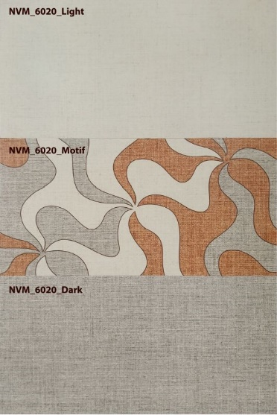
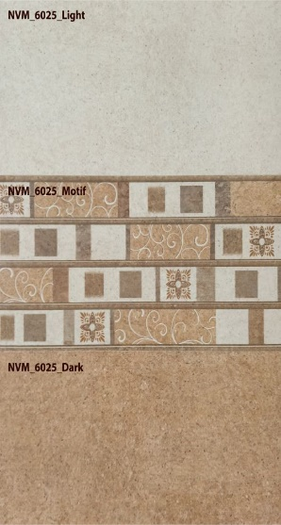
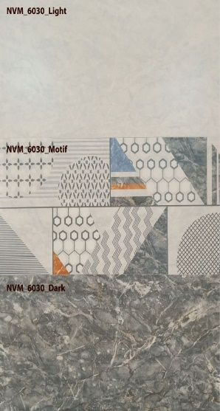
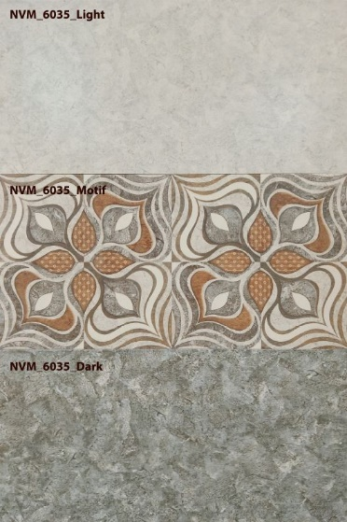
Why Karam Ceramics Ltd?
A total Range of 12 Number of design set were launched (3 Tiles per set (a) Light Color (b) Dark Color (c) Motive was one set

Slide 6
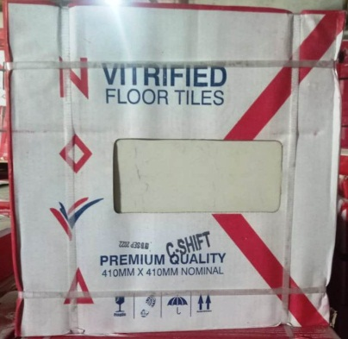
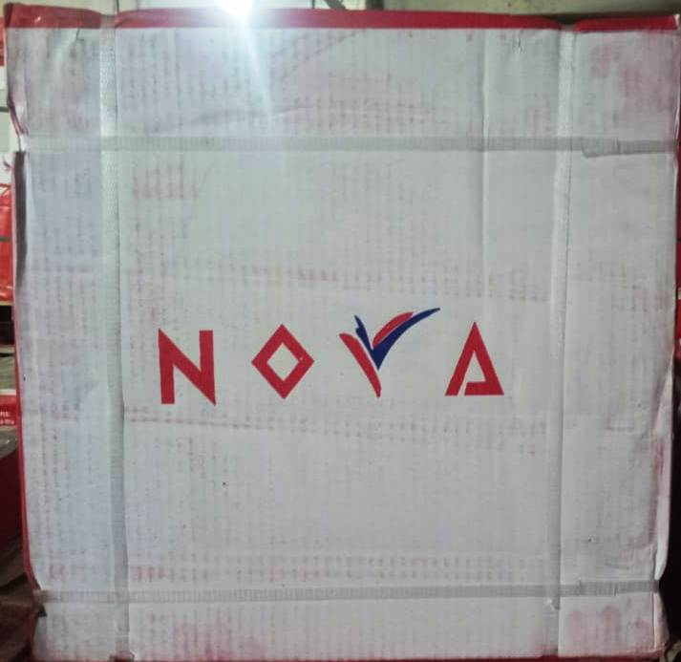
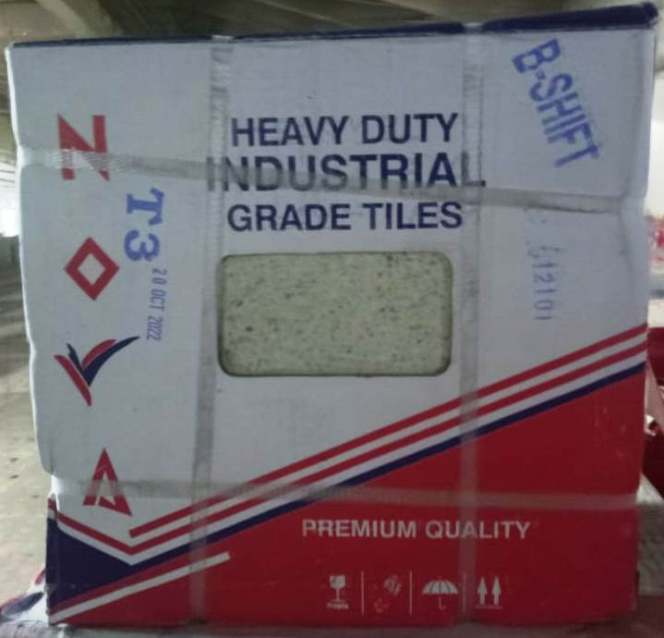
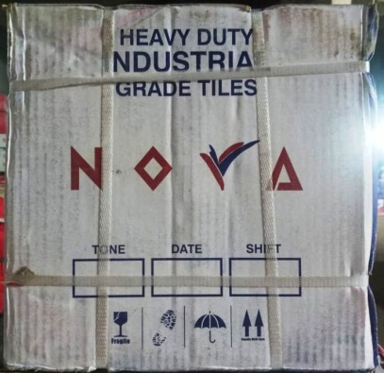
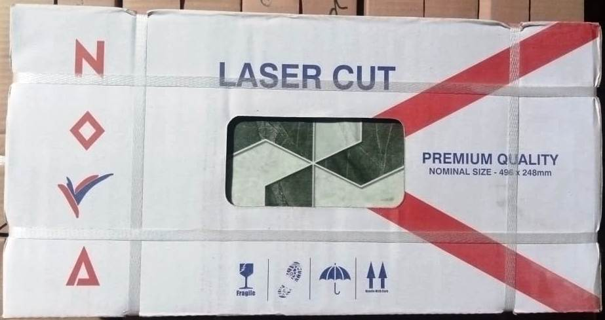
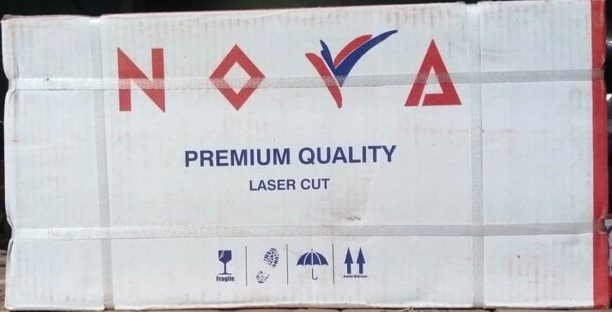
Why Karam Ceramics Ltd?
Design of new Boxes for Floor + Wall Tiles

Slide 7
Category of Shareholders 30 June 2022

Slide 8
Product Portfolio
COLOURED & DECORATIVE / EFFECT GLAZE WALL TILES
10 X 20
12 X 12
10 X 10
16 X 16

Slide 9
KEY FINANCIALS HIGHLIGHTS

Slide 10
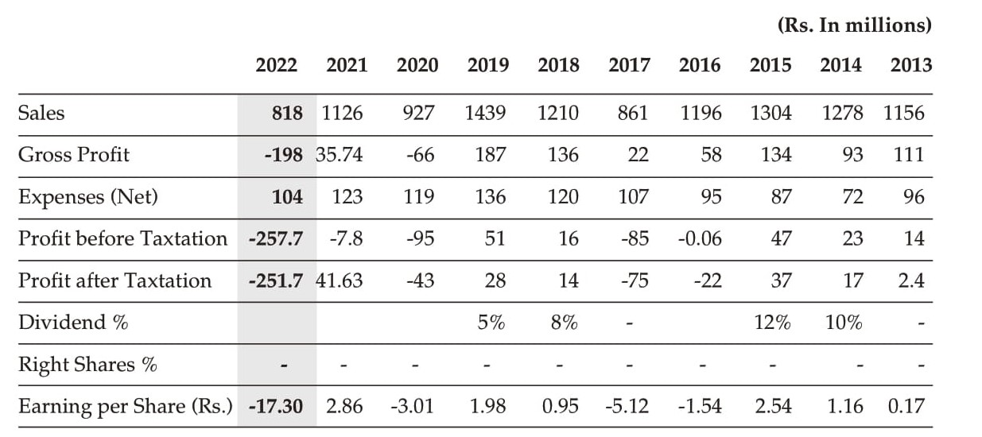
Financial Highlights

Slide 11
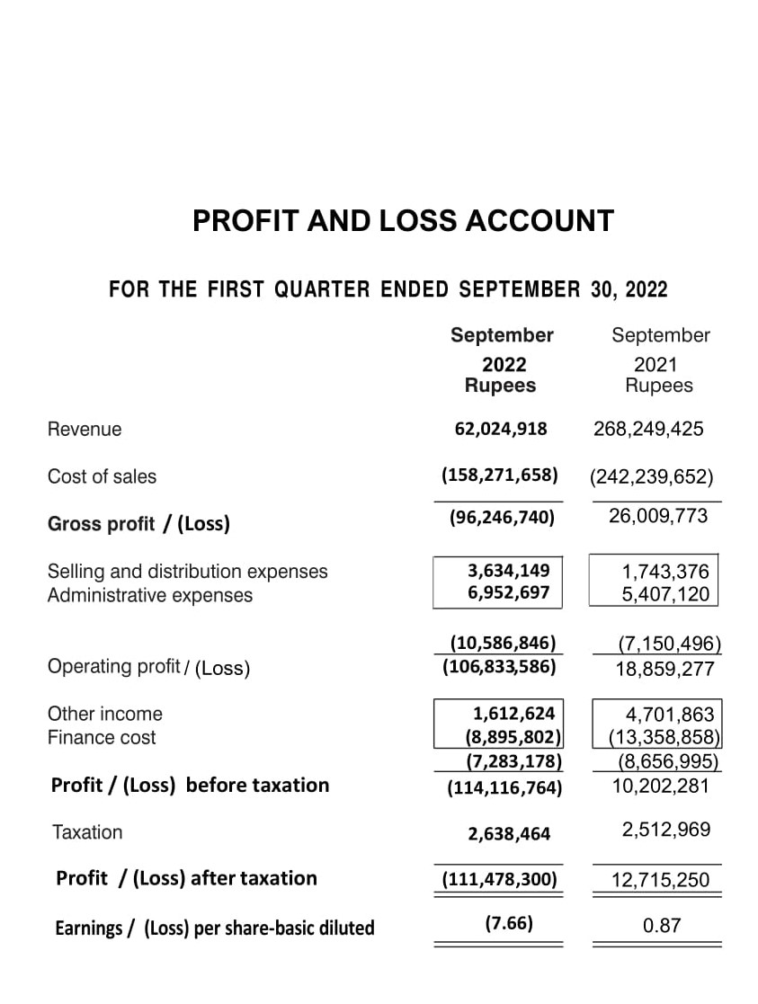
PERFORMANCE – QTR WISE

Slide 12
KEY CHALLENGES

Slide 13
KEY CHALLENGES – 2021-22
MARKET CHALLENGES
Imposition of multiple changes
High Energy cost
New companies entering in the market

Slide 14
Q&A
THANK YOU!

